Slide 1

Intel Unnati Industrial Training Report
Date: 4th July 2024
Problem statement: Running GenAI on Intel AI Laptops and Simple LLM Inference on CPU and fine-tuning of LLM Models using Intel® OpenVINO™ .
Submitted by: Aakash Gangurde
Institute: Manipal Institute of Technology
Registration number: 210968192
Institute Faculty Mentor: Shilpa Suresh (shilpa.suresh@manipal.edu)

Slide 2
Problem Statement
Our problem statement is Running GenAI on Intel AI Laptops and Simple LLM Inference on CPU and fine-tuning of LLM Models using Intel® OpenVINO™.
It can be understood that we need to run a pretrained transformer also known as GPT, generative pre training and create a chatbot which can be used in a question answer conversation.
LLMs or Large Language Models use a structure called as transformers which is a type or neural network architecture which is the foundation for many state-of-the-art Natural Language Processing models.
Many popular LLMs include
GPT3 (Generative Pre-Training V3)
T5 (Made by google Text-To-Text Transfer Transformer)
BERT (Bidirectional Encoder Representation from Transformers)
The main hurdles are:
Large size of the models which have billions of parameters which need a huge amount of memory, space and computational resources
Leveraging legacy hardware and the resources which are available on the machine which might result in high latencies between a question asked by a user and the answer generated by our fine-tuned model.

Slide 3
Unique Idea Brief (Solution)
Since intel openVINO is an open-source toolkit used for accelerating, optimizing and deploying LLMs (Large Language Models) on the edge and on the cloud irrespective of the hardware present on the computing machines.
It also allows very large language models which require a lot of memory and space to be run locally on any intel machine. Since the problem was to run an LLM on the edge then what better way to do that than to run a chatbot locally to answer all your questions. So we will select an efficient model convert it to an IR(Intermediate representation) and fine-tune it and then run inference locally.
The reason why we are going with gpt2 because it is the state-of-the-art language model developed by OpenAI which has parameters anywhere between 124M and 1.5B. GPT-2 comes in various sizes with different numbers of layers (transformer blocks), hidden units, and attention heads.
The input to GPT-2 is a sequence of tokens, which are numerical representations of words or subwords. The output is also a sequence of tokens, which can be converted back to text using the tokenizer.
Some of the limitations using gpt2 are:
Bias and Ethical Concerns:
Like many large language models, GPT-2 can produce biased or harmful content, reflecting the biases present in the training data.
It is important to use such models responsibly and be aware of their limitations.
Resource Intensive:
Running GPT-2, especially the larger versions, requires significant computational resources, including powerful GPUs and a substantial amount of memory
We will also be using NNCF and optimum-intel inorder to reduce the model size and weight compression as we need to be efficient with legacy computational resources. Weight compression makes the method efficient, but the precision is compromised.

Slide 4
Features offered
The gpt2 transformer while having comparatively lesser number of parameters generates text outputs quite well even when it has been weight compressed.
We are going with INT8 precision in order to retain the accuracy of the answers generated to the questions asked by the user.
GPT-2 can perform tasks without explicit training for those tasks. For example, it can generate answers to questions, translate text, and summarize content by leveraging its pre-trained knowledge.
GPT-2 can be fine-tuned for specific tasks and domains, making it adaptable to various applications such as sentiment analysis, content generation, and more.
NNCF, Neural Network Compression Function it is responsible for the quantization of the model and optimizing the operation of the model while keeping it efficient as we are lacking huge computational resources and we need to run the GenAI model on the Edge.
GPT-2 is based on the transformer architecture, which uses self-attention mechanisms to capture dependencies between words in a text, allowing for better contextual understanding.
The conversation is stored in such a way that the context of the topics is retained and the model may be able to answer the questions with respect to the details provided along with it and not just the answer.
Since we will be deploying our model using gradio thus it will have a user friendly UI, just simple type the question which you want to ask and then you will get the answer generated by the model.

Slide 5
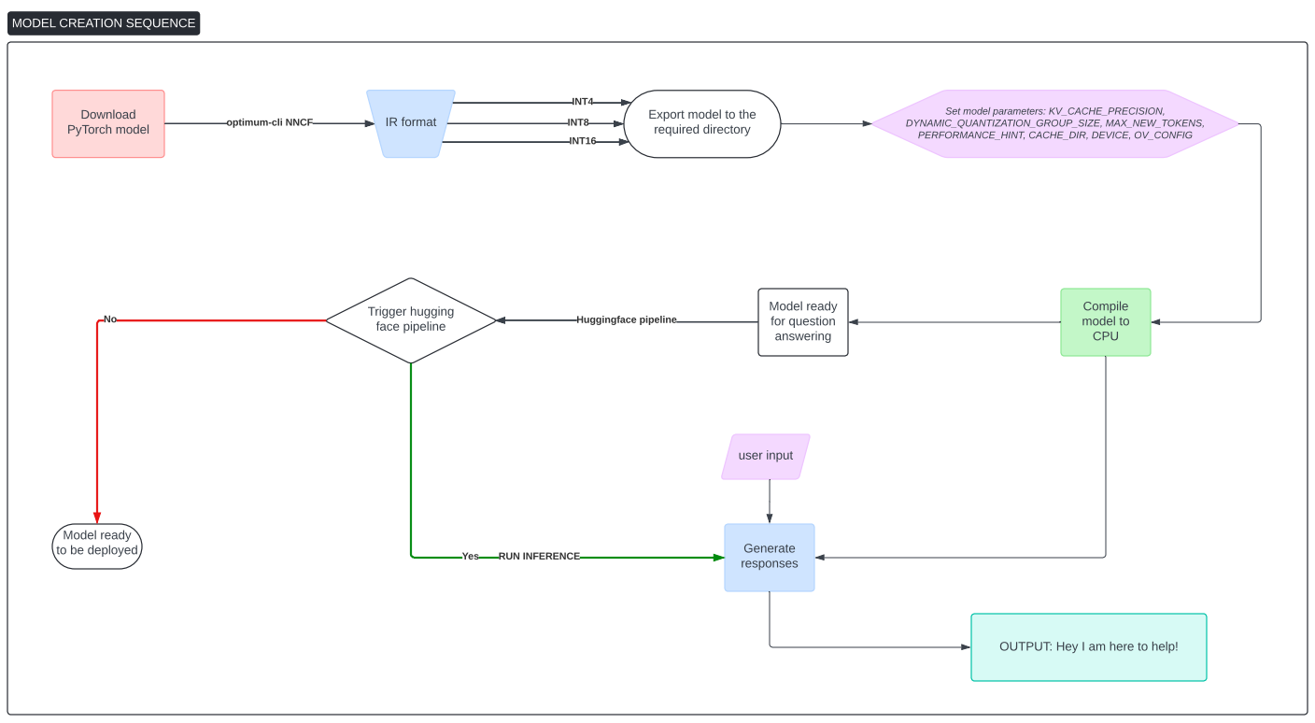
Process flow (intra model)
gpt2

Slide 6
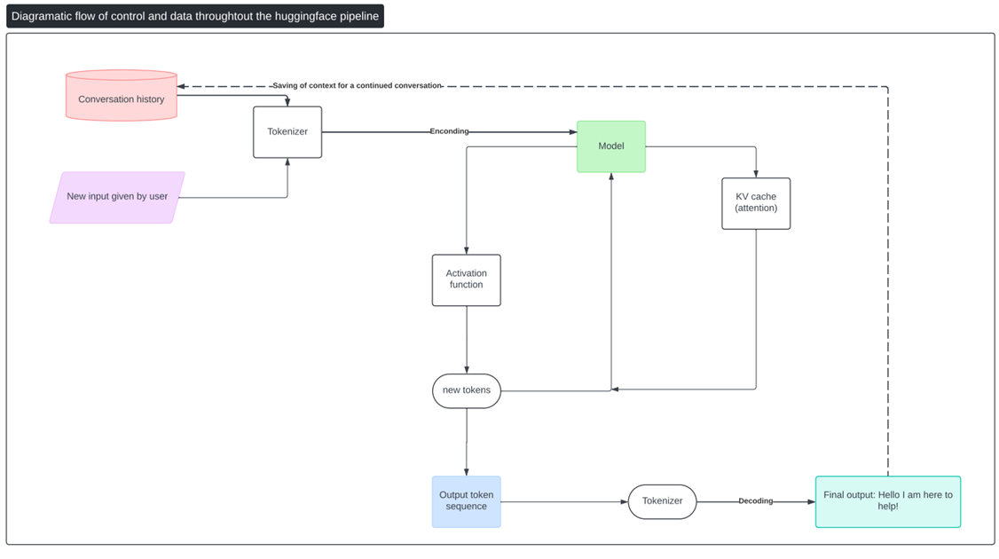
Process flow (after giving a prompt/question)

Slide 7
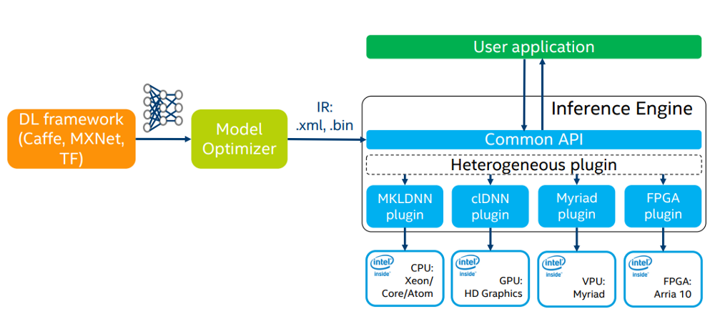
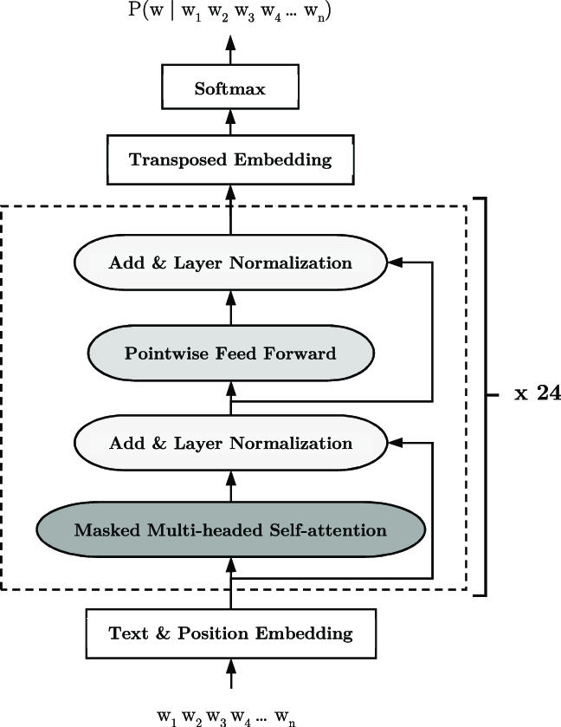
Architecture Diagram
Fig 2. How openVINO inference engine works by converting the deep learning model into an intermediate representation that the openVINO API can understand
Fig 1. Layers inside a gpt2 transformer

Slide 8
Technologies used
We are using intel OpenVINO an open source toolkit which allows optimization and quantization of large language models such that these heavy models can be ran on legacy hardware and on the edge.
Our model has been downloaded in the PyTorch framework which is also great to build neural networks with billions of parameters
We are using optimum-intel and NNCF for weight compression and to export our model with INT8 precision
We are using jupyter notebook and python language to run and interface with the model
We are using gradio which is a framework used to build GUIs over the internet, thanks to its free public hosting of 72 hours using which we have deployed our model on the internet.
We have used github to store and maintain our code.
The main framework which is the backbone to this project is hugging face, hugging face hub and hugging face pipeline. Using all these frameworks we were able to build our model and bind a flow of control to the model.
We are also using tokenizer and detokenizer to form the correct input and output generated by the model.

Slide 9
Team members and contribution (1 person only)
Since I am the only person, I have written all the code from downloading the model in the PyTorch framework, weight compression, deployment to writing the custom css for the gradio interface.
Some help was taken from online sources such as:
docs.openvino.ai
github repositories of intel
OpenVINO | 🦜️🔗 LangChain
Gradio python
Hugging face
Intel developer cloud
Youtube.com/AbhishekNandy
Medium/abhishek.nandy81
Gradio deployment and custom css designing is done by me and fonts have been used from google fonts.

Slide 10
Conclusion
By finishing this project, the understandings are that transformers are the foundational structures of LLMs and majority of them can be fine tuned to generate output which can be application specific.
Intel openVINO can be used to run large sized models on the edge and that too efficiently on legacy hardware and CPUs. Irrespective of the hardware used the optimized models can be run on any compatible intel based machine.
Weight compression is a crucial part of running LLMs on the edge and can be used for various applications where accessing the cloud computational resources takes loading times.
There are various parameters which are responsible for lower latencies while generating a response using the LLMs
Pipelining is important to maintain the flow of control and I/O from the beginning of entering a prompt till the end of generating the response.
Templating is also important for the model to understand in what way the tokens are needed to be generated so that they are grammatically correct.
Running CPU inference is a very helpful tool for applications where cloud computational resources are not necessarily required and the local hardware can finish the job within seconds.

Slide 11
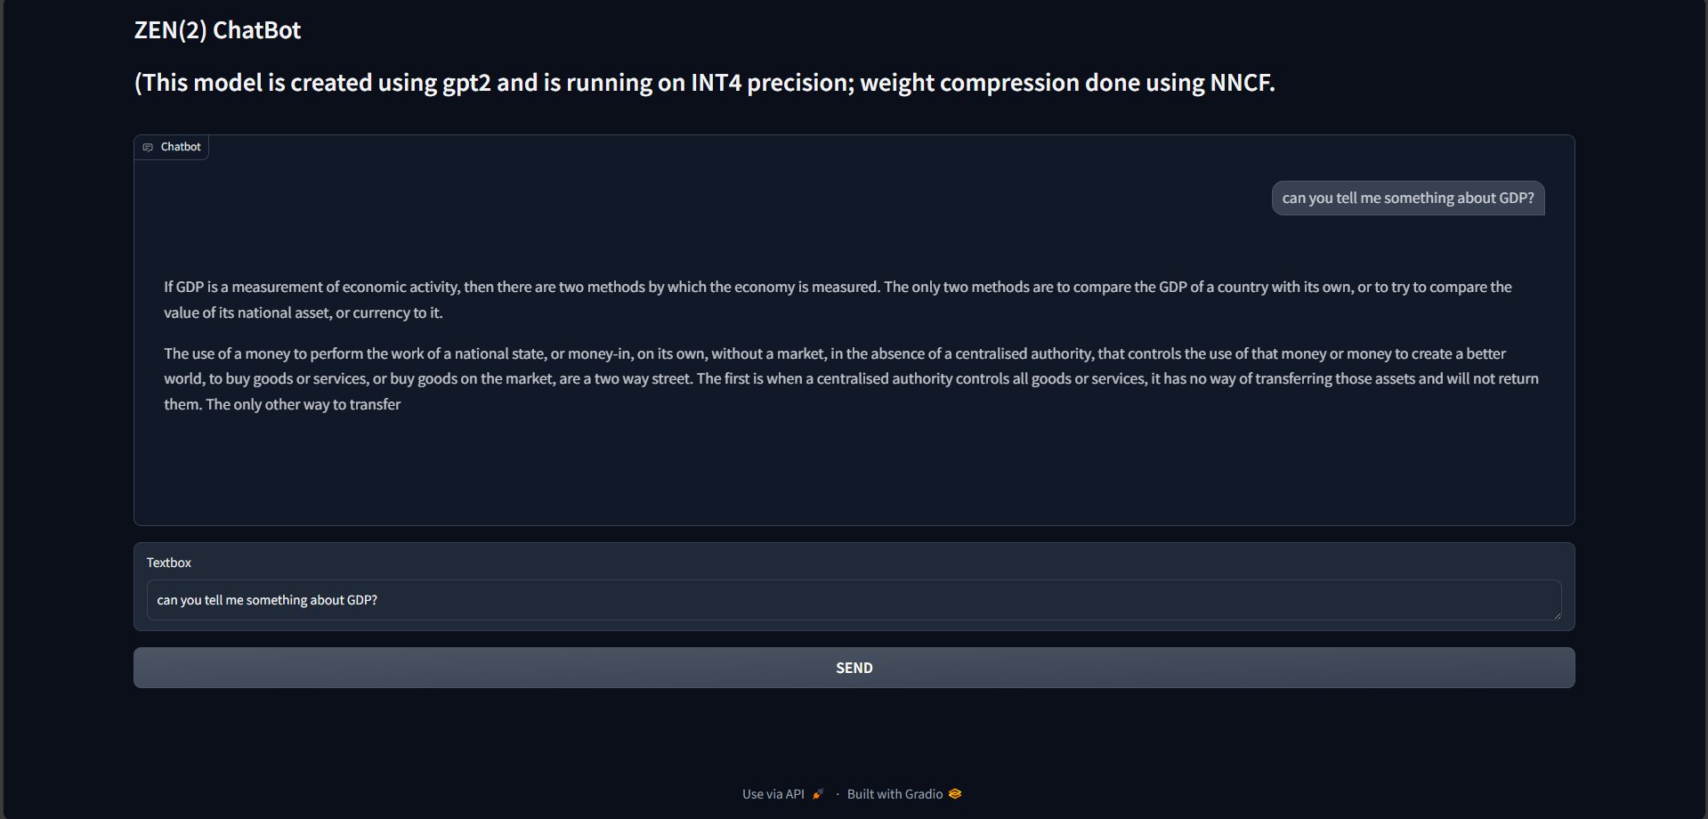
Images of the deployed project ZEN(2)

Slide 12
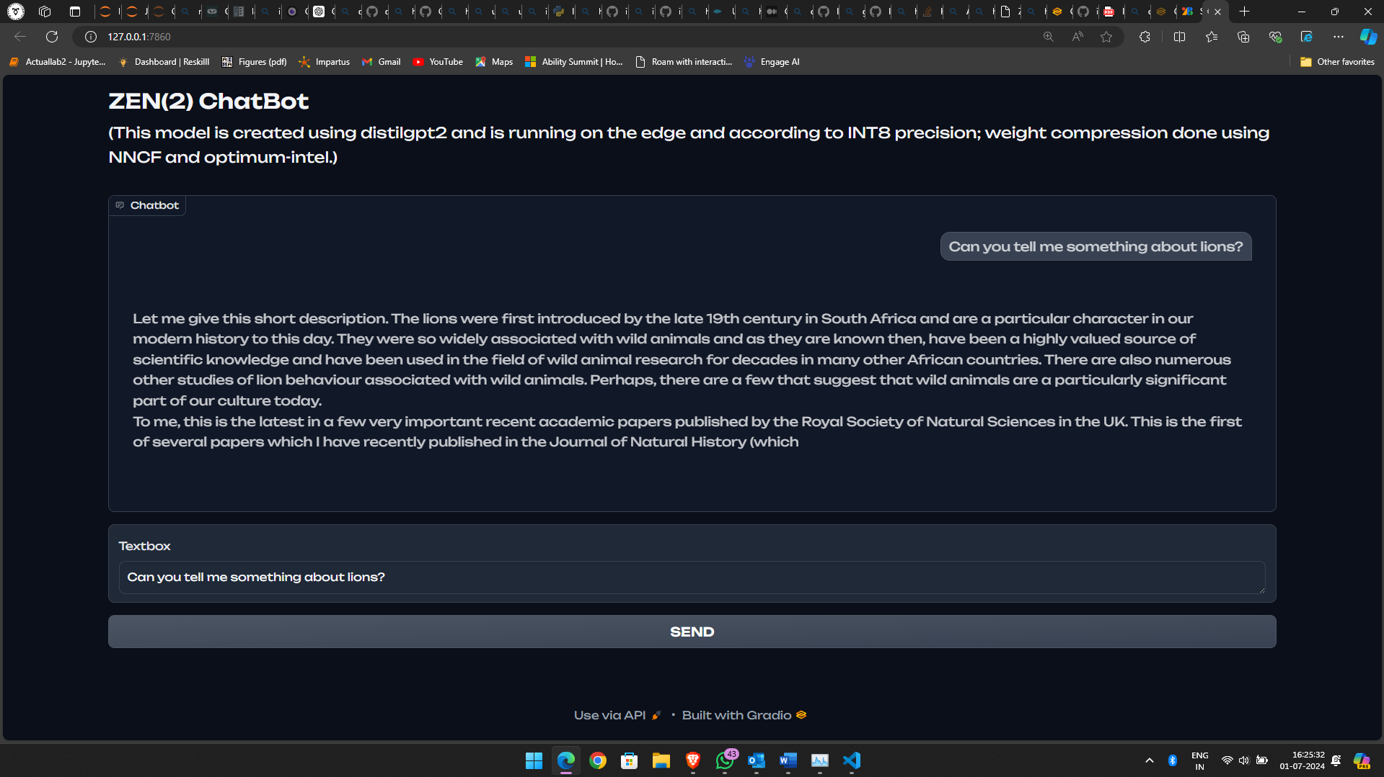
Images of the deployed project ZEN(2) using distilgpt2
(distilgpt2 is the smaller and more efficient form of gpt2 )

